Slide 1
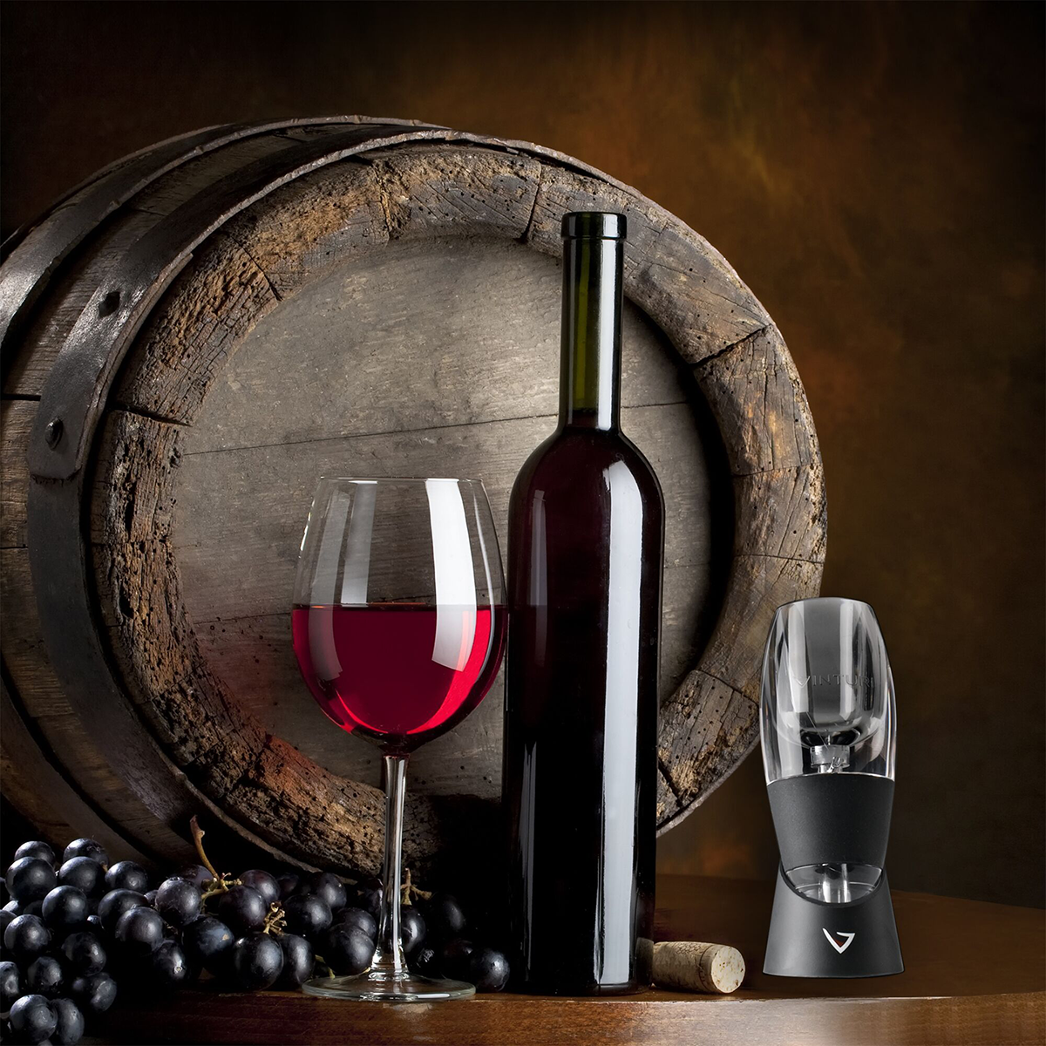

My First towards Data Mining & Machine Learning …
LINEAR Regression and Classification Modeling
On Wine Quality….
Kumar Chamarty….

Slide 2


A little Info about my Dataset….
Explanatory Variables
1 - fixed acidity 2 - volatile acidity 3 - citric acid 4 - residual sugar 5 - chlorides 6 - free sulfur dioxide 7 - total sulfur dioxide 8- pH 9 - sulphates 10 – alcohol 11 - density (for classifications only)
Fixed Acidity – composed of acids like tartaric, malic, succinic acid (produced during fermentation) which contribute to taste and color.
volatile acidity - primarily acetic acid but also lactic, formic, butyric, and propionic acids. limit is 1.2 g/L
Free vs Total So2: the portion of SO2 that is free in the wine vs the portion that is bound to other chemicals
Response Variable
For Regression
Density
For Classification
Quality of Wine!
Quality >> 3level_Rating

Slide 3
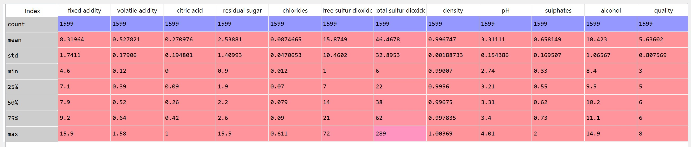
Data Description …

Slide 4
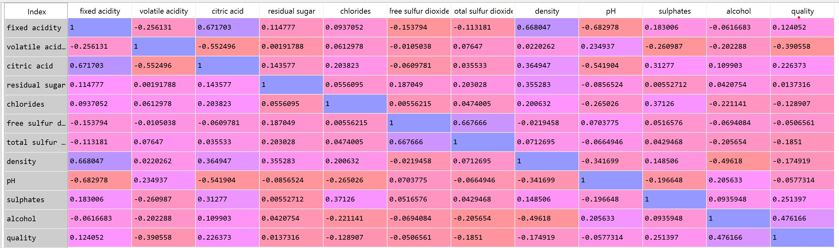
Pearson Correlation between all Variables

Slide 5
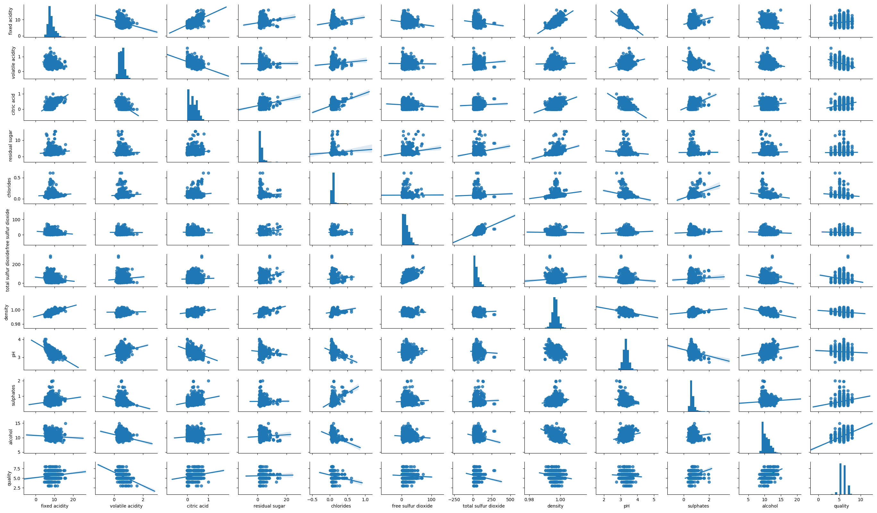
Pair-Wise Plotting Kind=‘Reg’ diag=‘histogram’
Citric Acid Vs Volatile Acidity
Chlorides Vs Citric Acid
Total vs Free Sulphur Dioxide
Fixed Acidity vs PH
Chlorides vs Alcohol

Slide 6
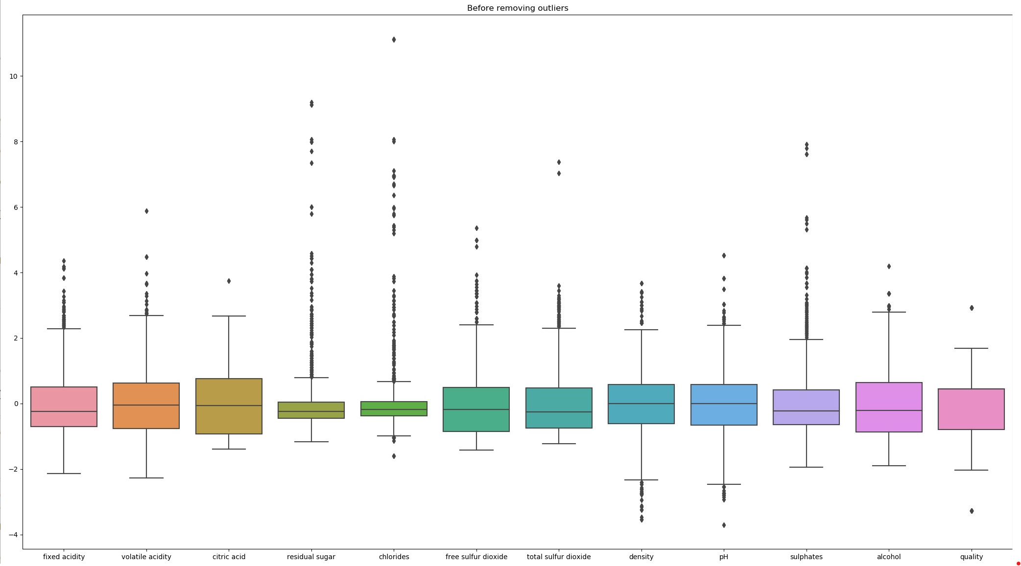
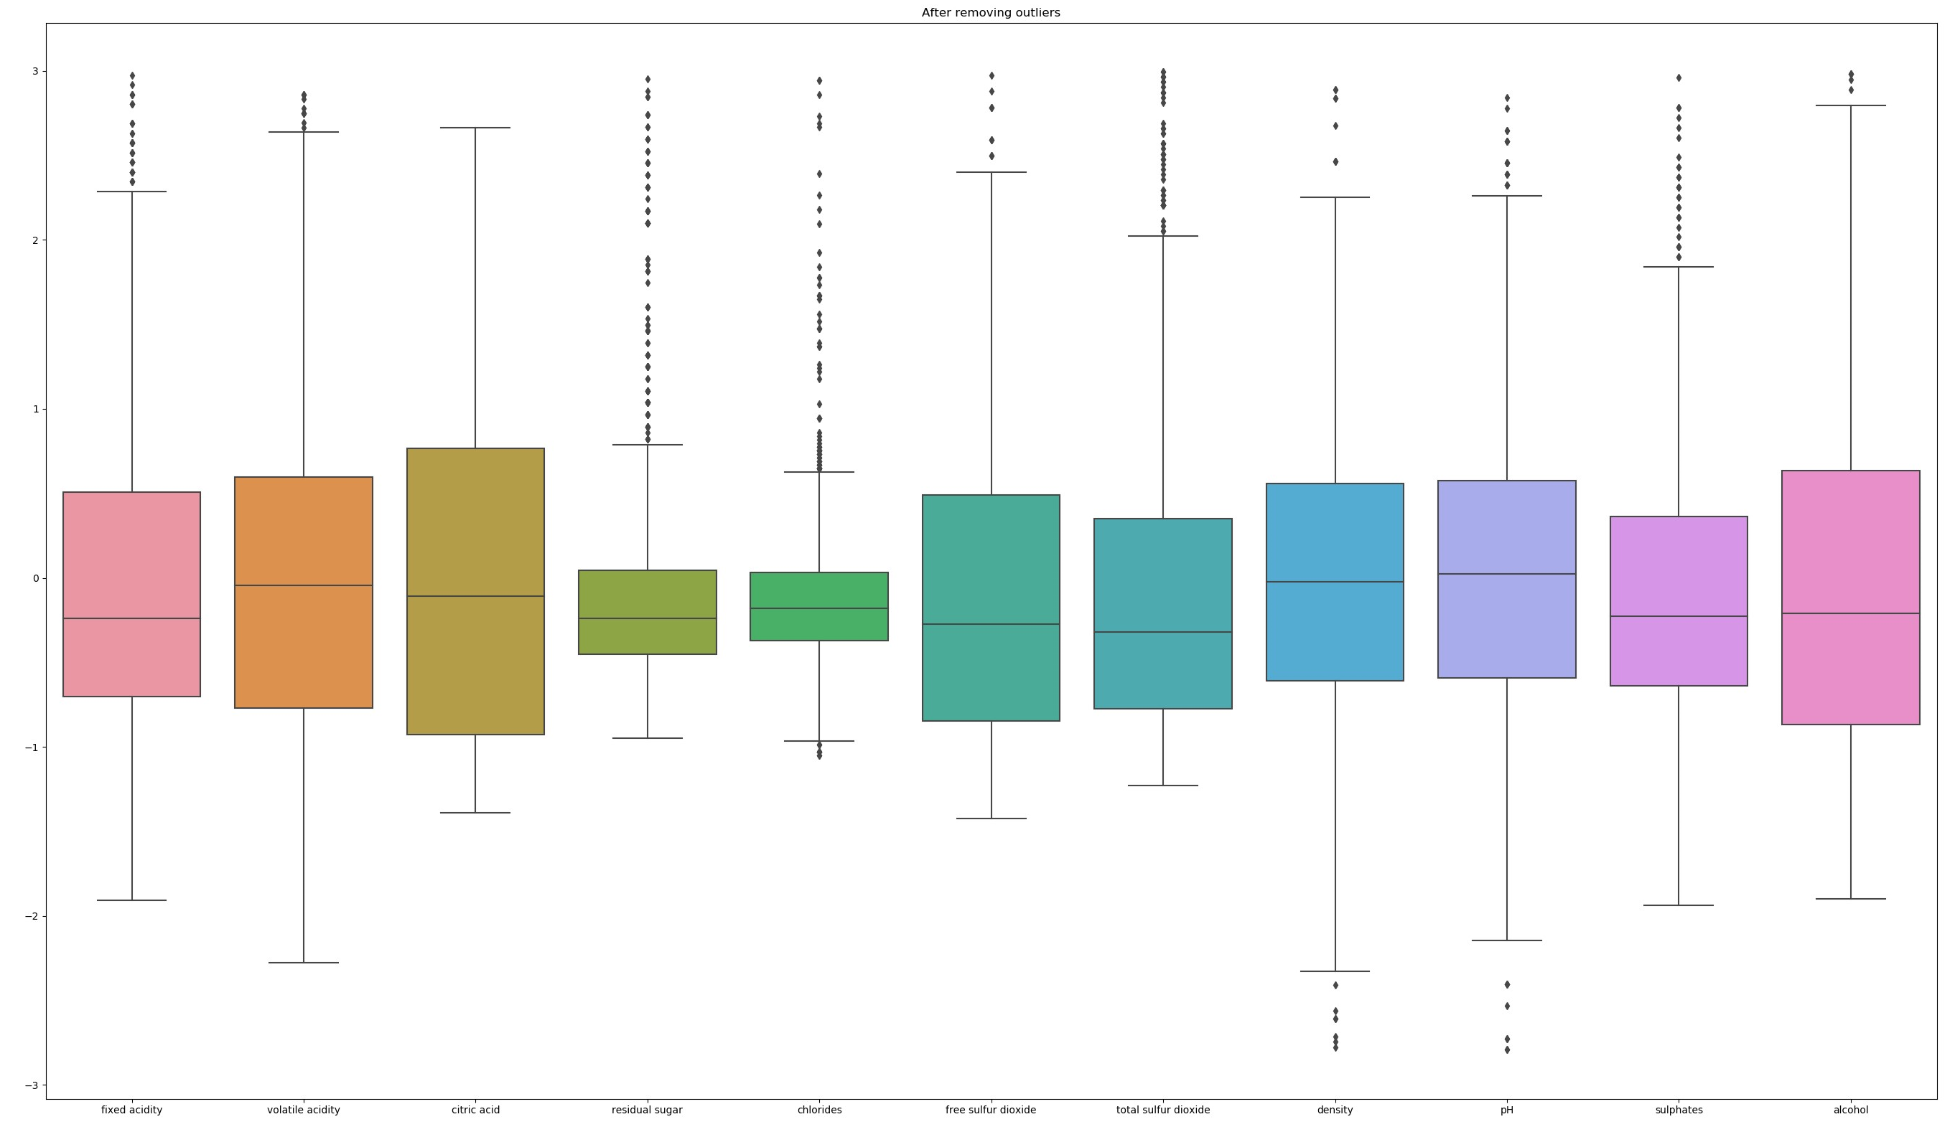
Dealing with Outliers using Z>3

Slide 7
Linear Regression using OLS and K-Fold Validation
We used OLS – Ordinary Least Squares Method to train our data set.
(The Betas are chosen in way so that the sum of squares of errors is the least)
2. We have set our significance level at 0.05.
3. So, In backward feature elimination, we can get rid of the variables for which pvalue is > alpha (0.05)
4. We use K-Fold mechanism to validate our Model results.
********
Our predictor variable is Density

Slide 8
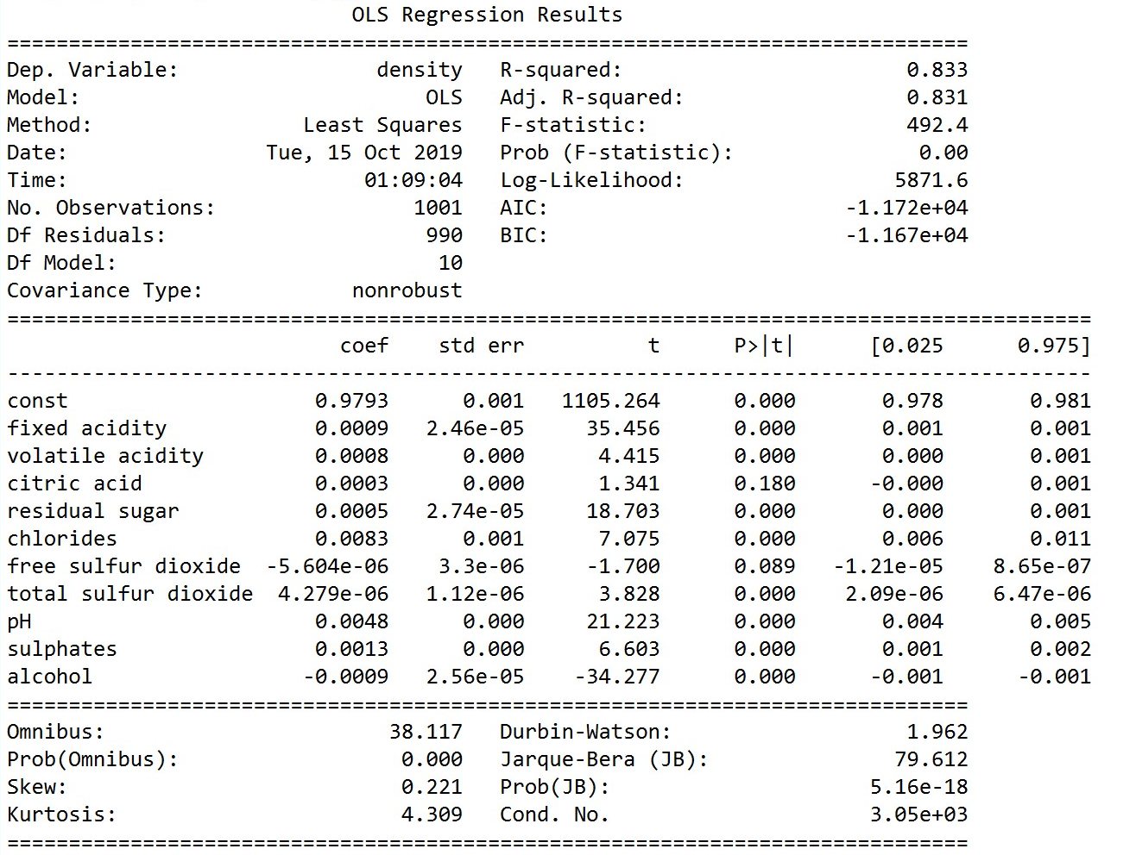
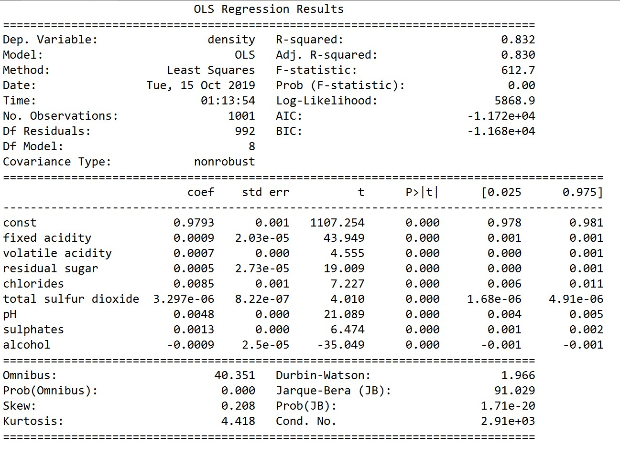
Backward Feature Elimination
at significance level 0.05

Slide 9
Our Linear Regression Model for Density is
density = 0.9793 + 0.0009 (fixed acidity) + 0.0008(volatile acidity) + 0.0003(citric acid) + 0.0005(residual sugar)+ 0.0083(chlorides) - 5.604e-06(free sulfur dioxide )+ 4.279e-06(total sulfur dioxide) + 0.0048(pH) + 0.0013(sulphates)- 0.0009(alcohol)

Slide 10
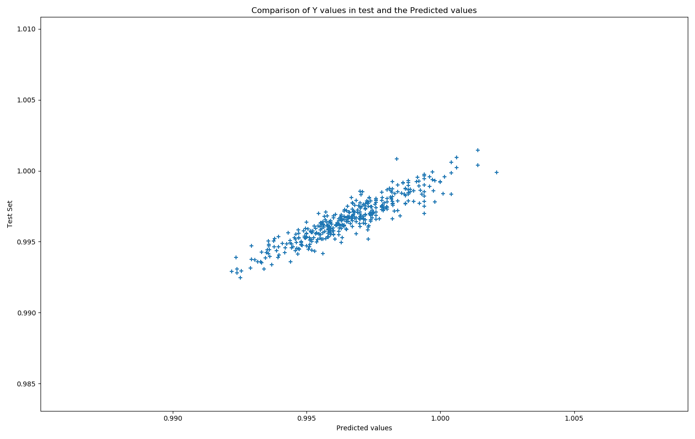
Predicted Vs Observed :
Other stats were observed as
R2_Test =0.7234029747928733
MAE : 0.0004990134966571934
MSE : 4.334011706145961e-07
RMSE : 0.0006583321127019372

Slide 11
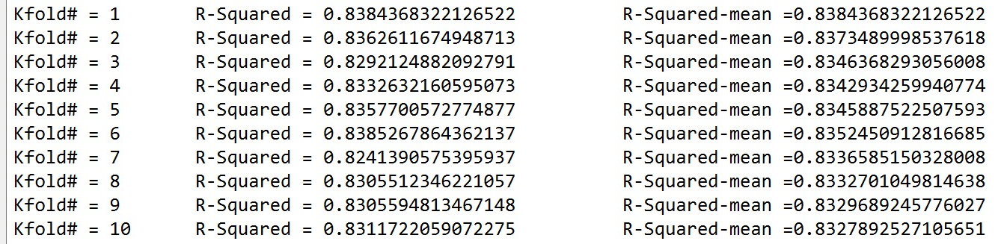
K-Fold and R-squared Values for Linear Regression
We used the entire dataset.
‘citric Acid’ column was dropped as part of Backward Feature Elimination
Our New Prediction Model :
Density = 0.9794 +0.0009(fixed acidity) + 0.0006(residual sugar) + 0.0071 (chlorides) - 1.067e-05(free sulfur dioxide) + 4.938e-06(total sulfur dioxide) + 0.0051(pH) + 0.0010(sulphates) - 0.0009(alcohol)

Slide 12
Conclusion:
I was able to get a model with better Accuracy when I used the entire training Dataset.
The SSR or Rsquared Value was found to be around 83% when we used one sample set to train the dataset.
Even with K-Fold Validation, we got about similar results, which suggests we can deploy the model.

Slide 13
Classification using Logistic Regression and Decision Trees
1. Used the Logistic Regression Model to predict the Quality of Wine.
2. Compared the performance against Decision Tree with the Genie Criterion.
********
Our predictor variable is Quatliy with 8 classes
Encoded Quality variable into LR3 with only 3 classes to get better Accuracy scores.

Slide 14
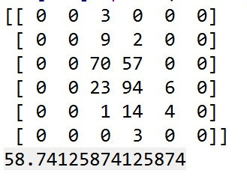
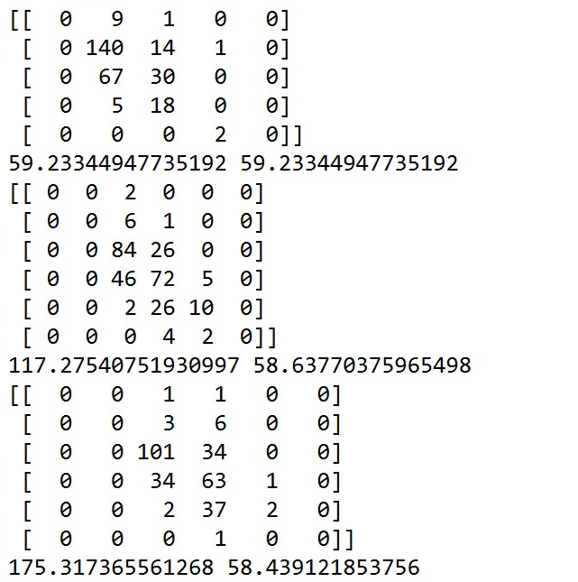
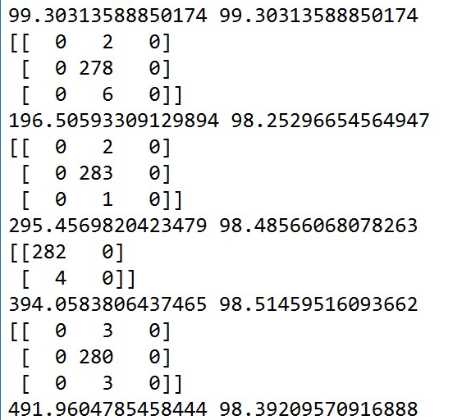
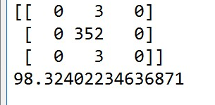
Logistic Regression – Confusion Matrix and Accuracies and K-Fold Comparisons
CM for Y with 8 classes
CM for Y with 8 classes & K=3
CM for Y with 3 classes &k=5
CM for Y with 3 classes

Slide 15
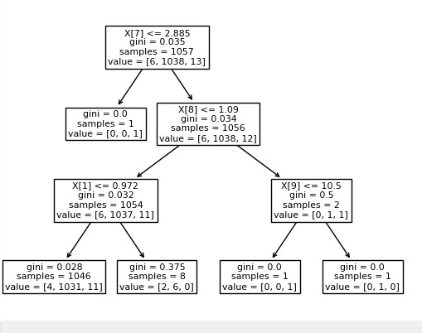
Decision Tree
Rules
For
criterion = ‘Gini’
max_depth=3, splitter='best'

Slide 16
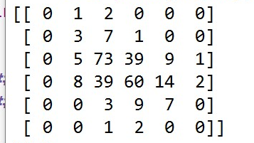
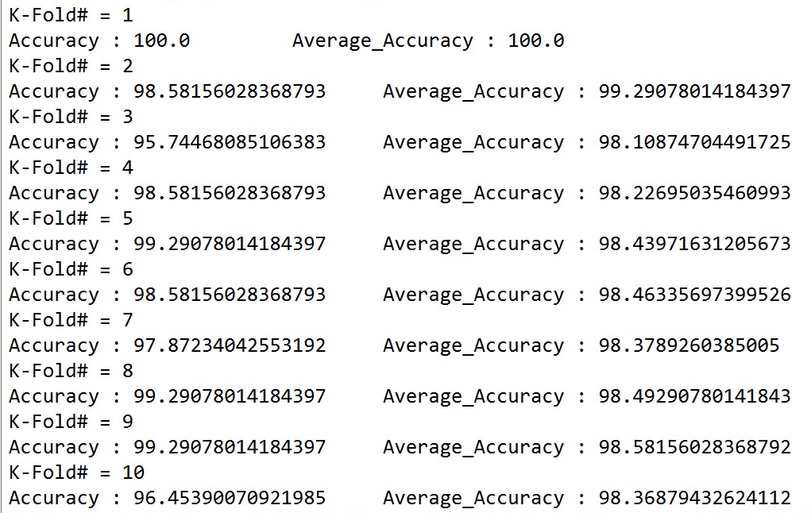
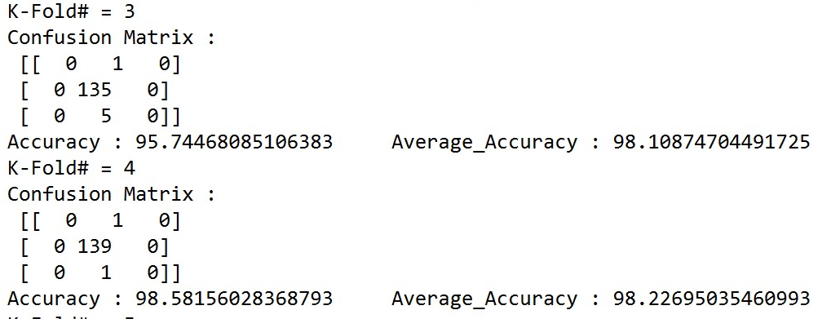
Decision Tree Classifier– Confusion Matrix and Accuracies and K-Fold Comparisons
CM for Y with 8 classes
Accuracies with 3 classes and K-Fold
Accuracy is 50%
CM and Accuracies for Y with 3 classes

Slide 17
Conclusion:
The Accuracy is very low when we have more number of classes for both Logistic Regression and Decision Tree.
Logistic Regression seems to do slightly better than Decision Tree with Depth=3 for my Dataset.

Slide 18
Thank You…!

